Slide 1
Supporting Industry 4.0 in Next-generation Cellular: The Digital Twin Use Case
R2T2 2021
https://www.telematica.polito.it/member/carla-fabiana-chiasserini/
Carla Fabiana Chiasserini, Politecnico di Torino

Slide 2
1
New-generation cellular

Slide 3
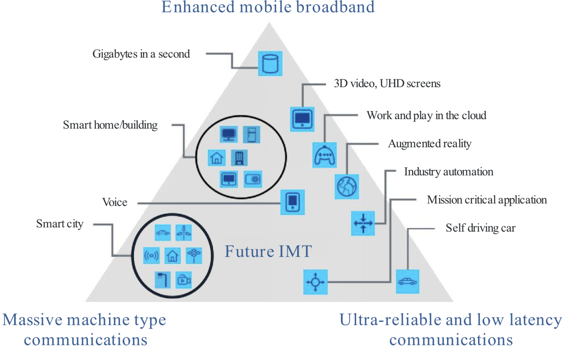
What is/was a breakthrough in 5G?
Vertical industries become customers of mobile networks
Verticals specify their quality of service requirements (not limited to data rate any longer)
Source: IMT vision Recommendation ITU-R M.2083-0

Slide 4
How is it possible to host vertical services with ultra low (UL) latency?

Slide 5
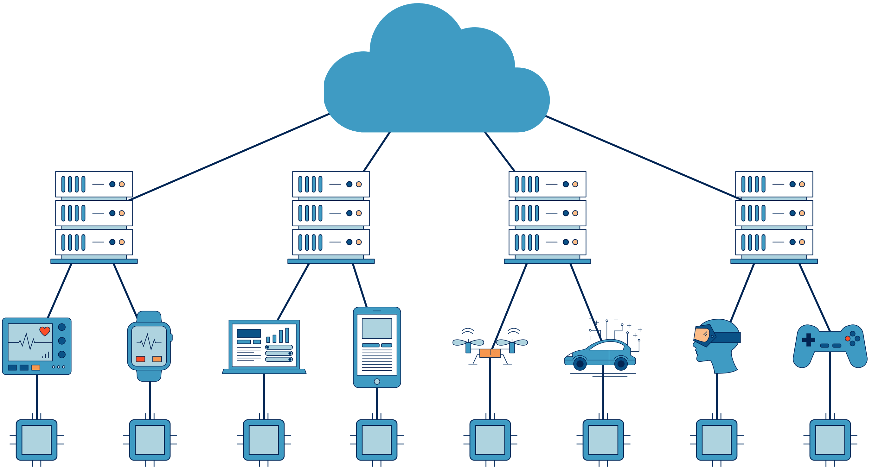
How is it possible to host vertical services with UL latency? First, network as a programmable platform
Edge computing: the network as a programmable platform
Network will process and store data, not just transfer it
Processing and applications within the network to provide mobile users with services
Lower delays and higher efficiency

Slide 6
How is it possible to host vertical services with UL latency? First, network as a programmable platform
SDN as a key technology
Northbound interface: Network control API
Controller/Network OS
Southbound interface: HW open interface
Simple forwarding HW
Simple forwarding HW
Physical infrastructure
Simple forwarding HW
Simple forwarding HW
Capone – Netsoft 2015

Slide 7
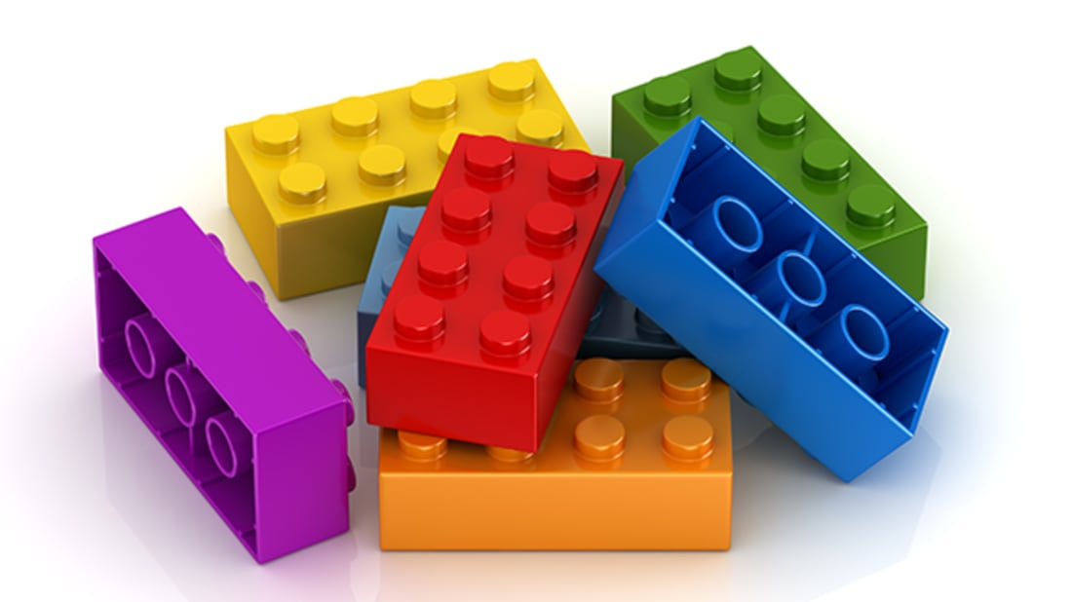
How is it possible to host vertical services with UL latency? Second, service virtualization
Service
Management and Orchestration MANO
Virtual Functions VNFs
NFV World Congress - OSM

Slide 8
NFV, SDN, MANO: ETSI Architectural view
MANO
Verticals
NFV Orchestrator
OSS/BSS
Service
VNF
VNF
VNF
VNF
VNF
VNF/VA Manager
NFVI
Physical
resources
Virtual Infrastructure Manager (VIM)
Virtual Computing
Virtual Storage
Virtual Network
Virtualization @ SDN Controller
Computing
Storage
Network
SDN world
Hardware Resources

Slide 9
NFV, SDN, MANO: ETSI Architectural view
MANO
Verticals
NFV Orchestrator
OSS/BSS
Service
VNF
VNF
VNF
VNF
VNF
VNF/VA Manager
NFVI
Physical
resources
Virtual Infrastructure Manager (VIM)
Virtual Computing
Virtual Storage
Virtual Network
Virtualization @ SDN Controller
Computing
Storage
Network
SDN world
Hardware Resources

Slide 10
How is this possible to host vertical services with UL latency? First, network as a programmable platform
Edge computing: the network as a programmable platform
Network will process and store data, not just transfer it
Processing and applications within the network to provide mobile users with services
Lower delays and higher efficiency

Slide 11
How is it possible to host vertical services, each with the required quality of service (QoS)?

Slide 12
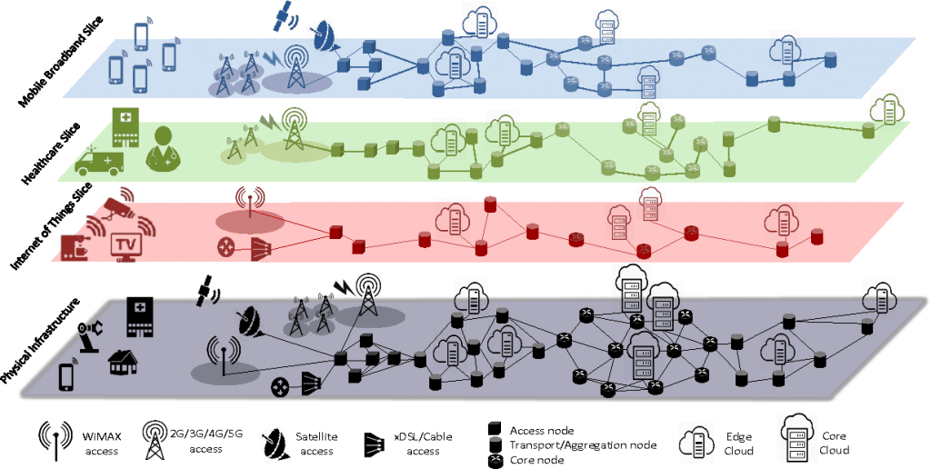
How is it possible to host vertical services each with the required QoS? Network slicing
Virtualization allows to slice the network into virtual subnetworks (separated sets of resources)
Service deployment = Creating a slice hosting the virtual function set

Slide 13
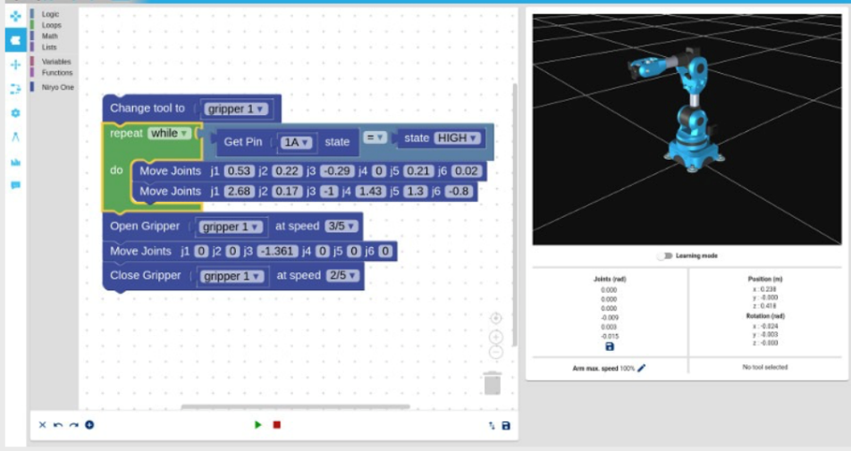
Use Case: Digital Twin
EDGE NETWORK
Digital Twin app
Interface
VNF 1 target latency: 600 ms
Motion planning
Control
Coordinates
VNF 2
target latency: 60 ms
Drivers
Commands
Radio Access Network

Slide 14
Challenges
Vertical service deployment (VNF placement and resource allocation) ⎯ yet lots to learn, especially in presence of dynamic conditions
Virtualization at the Edge poses a performance issue, especially in terms of latency (strict delay constraints), and a cost issue - big concern for Verticals and Mobile Operators
End-to-end slicing

Slide 15
2
End-to-end slicing

Slide 16
Industry 4.0: Digital Twin
Is VERTICAL service virtualization the only one that matters?

Slide 18
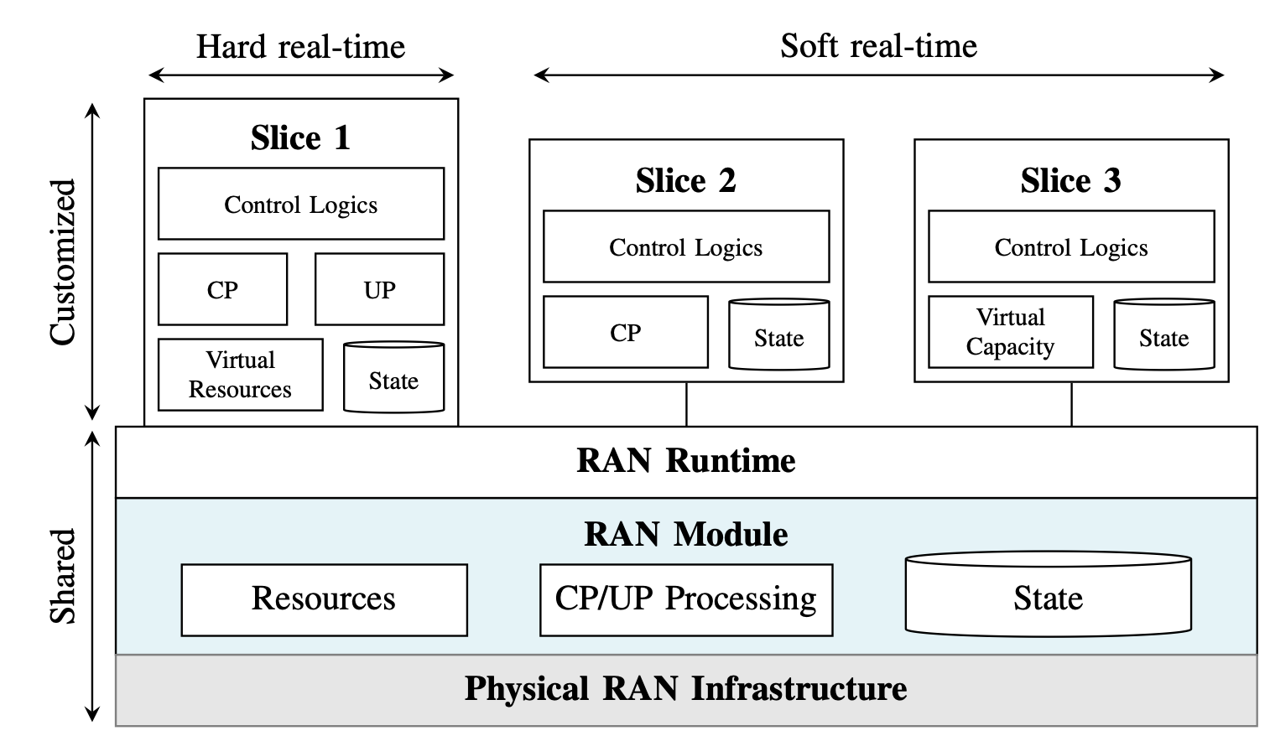
vRAN
Chang et al. RAN Runtime Slicing System for Flexible and Dynamic Service Execution Environment. IEEE Access 6, 34018–34042, and Schmidt et al. Radio Access Network Slicing System, Eurecom

Slide 19
Possible approaches
AIML-based approaches for allocation of (all types) of resources, i.e., E2E slice configuration:
centralized (coarse) resource allocation
distributed fine tuning
Network edge as set of distributed entities:
centralized ML architectures
distributed ML architectures

Slide 20
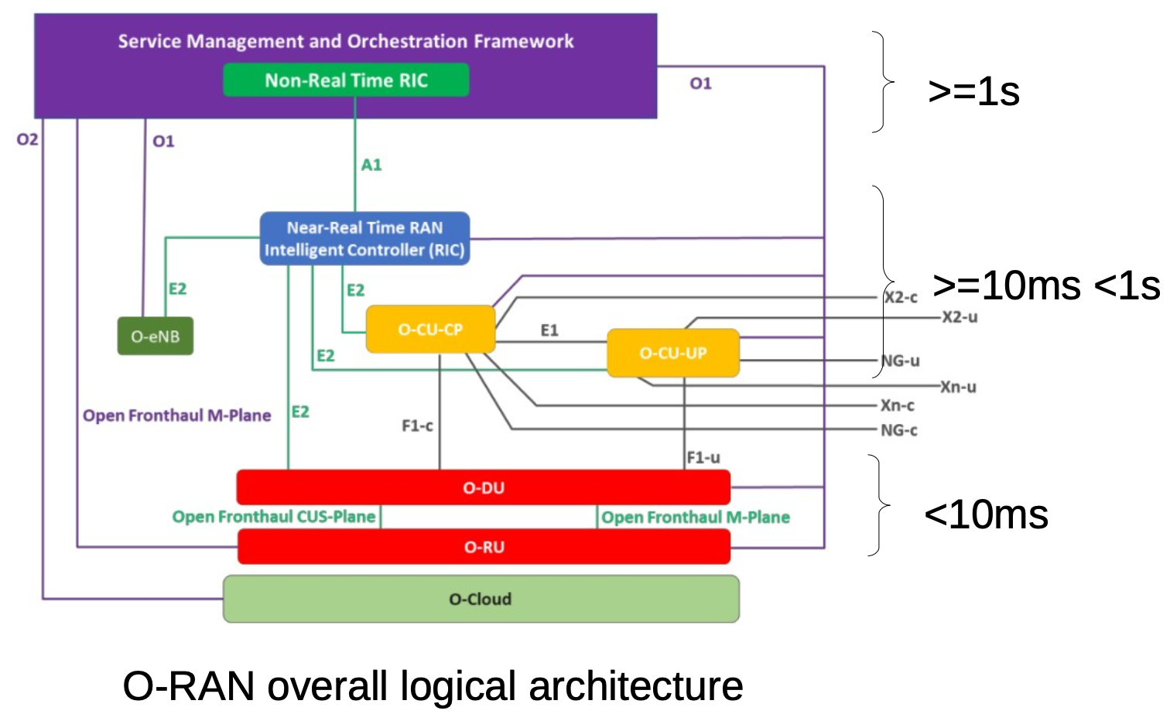
O-RAN

Slide 21
Recent work
Edge-controlled or edge-assisted systems
Machine learning involving edge / fog
Vrain by NEC et al.
ML-based settings of an LTE vRAN (srsLTE) accounting for CPU consumption
CAREM: ML-based, application-aware management of multiple links* through vRAN
S. Tripathi, C. Puligheddu, C. Chiasserini, An RL Approach to Radio Resource Management in Heterogeneous Virtual RANs, IEEE WONS 2021

Slide 22
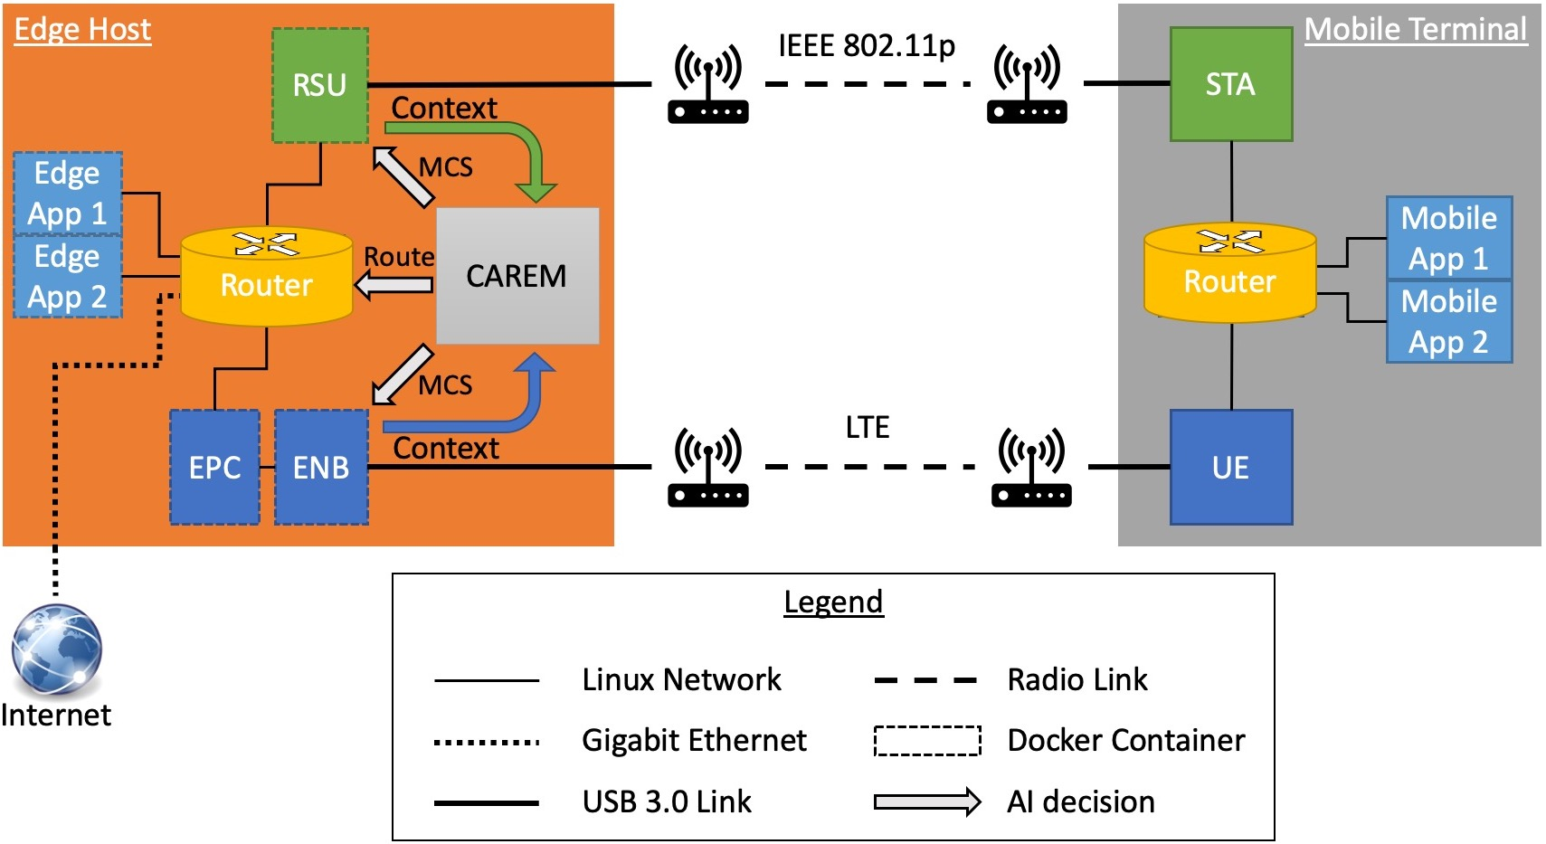
CAREM: Context-aware Radio Resource Management
17

Slide 23
3
Management of computing resources under dynamic service load

Slide 24
Use Case: Digital Twin
EDGE NETWORK
Digital Twin app
Interface
VNF 1 target latency: 600 ms
Motion planning
Control
Coordinates
VNF 2
target latency: 60 ms
Drivers
Commands
RAN

Slide 25
Service scaling out/in
Measure CPU consumption: if above threshold, then scale out:
A new VM running VNF2 is instantiated, and the workload can be split between the different instances
Is a simple thresholding algorithm enough?

Slide 26
A ML Approach: An Example
Random Forest classification model
Input: current Instantiation Level (IL) and average per-VNF CPU load
Output: IL to apply
Model training and inference model creation
ave. CPU load
Classification Model
suitable no. of VNF instances
current no. of VNF instances
19

Slide 27
System architecture and operational flow
Vertical
2
Service request
AIML model upload and training
5GROWTH Vertical Entry Point
1
Interface for model onboarding
AI/ML Platform
ML lifecycle Mng
5GROWTH
Service
Orchestrator
YARN cluster manager
SLA manager
HDFS dataset storage
BigDL
Ray
6
AIML model request/response
Model execution
8
AI/ML param. register
Spark
MLlib
7
Monitoring manager
Interface Manager
Data consumption
AI/ML model register
Kafka
5
5GROWTH Vertical-oriented Monitoring System
Real-time
perf. metrics
5GROWTH Resource Layer
4
Topic configuration
3
Monitoring job configuration
Infrastructure
VM
VM
Logical Links
Physical Links
20

Slide 28
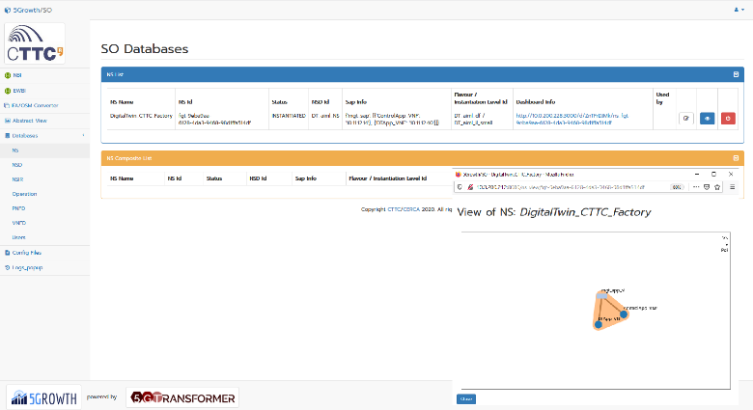
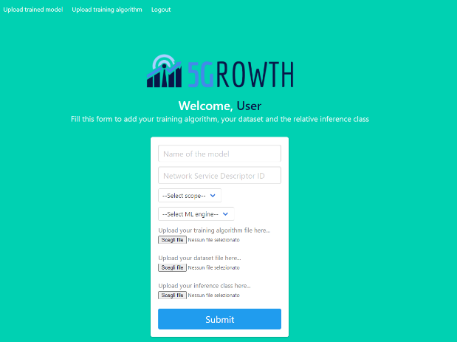
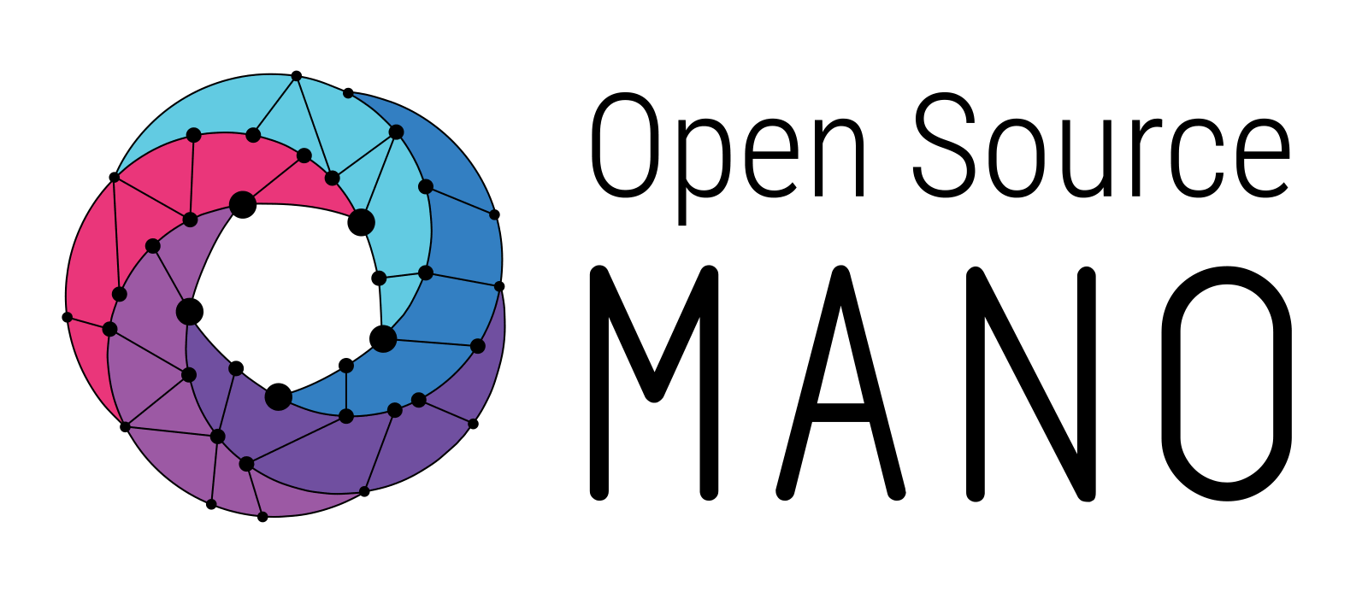
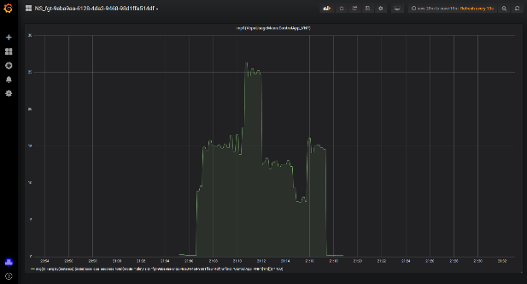
Deployed Scenario
5Growth MANO and Monitoring
VPN (data, control and management)
5Gr-VS
5Gr-SO
Monitoring
Model Execution
5Gr-RL
Interface for model onboarding
AI/ML Platform
ML lifecycle Mng
YARN cluster manager
VIM
WIM
HDFS dataset storage
BigDL
Ray
AI/ML param. register
Spark
VNF
MLlib
VNF
VNF
Interface Manager
AI/ML model register
Heterogeneous WAN transport network
Torino
Barcelona
Scaling operation
Scaling operation

Slide 29
ML at the edge is indeed effective in controlling/exploiting the heterogeneity of mobile networks at best
Demo
https://www.youtube.com/watch?v=7V3AKSrWzzY
Demo at IEEE NFV-SDN 2020 (Best demo award) and at INFOCOM 2021
23

Slide 30
Take-away Messages
- Edge: need it and actually works! - AI-driven, fully automatic management of e2e slices: using the most suitable resources from the cloud to the UE, for complex services and heterogeneous vRANs
- It works even under dynamic conditions

Slide 31
Thank you for your attention!

